Slide 1

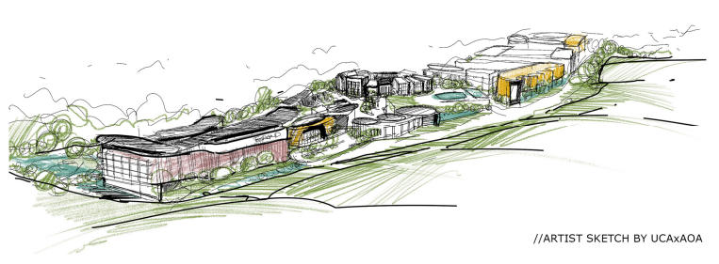
Meridian Luxe: Redefining Luxury Living in Southern Africa
A Luxury Mixed-Use Development on KwaZulu-Natal’s North Coast

Slide 2
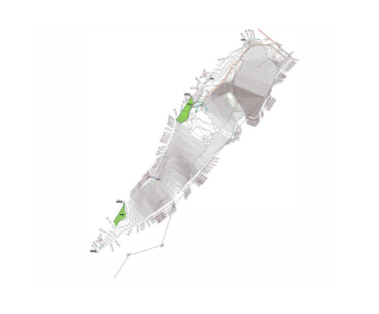
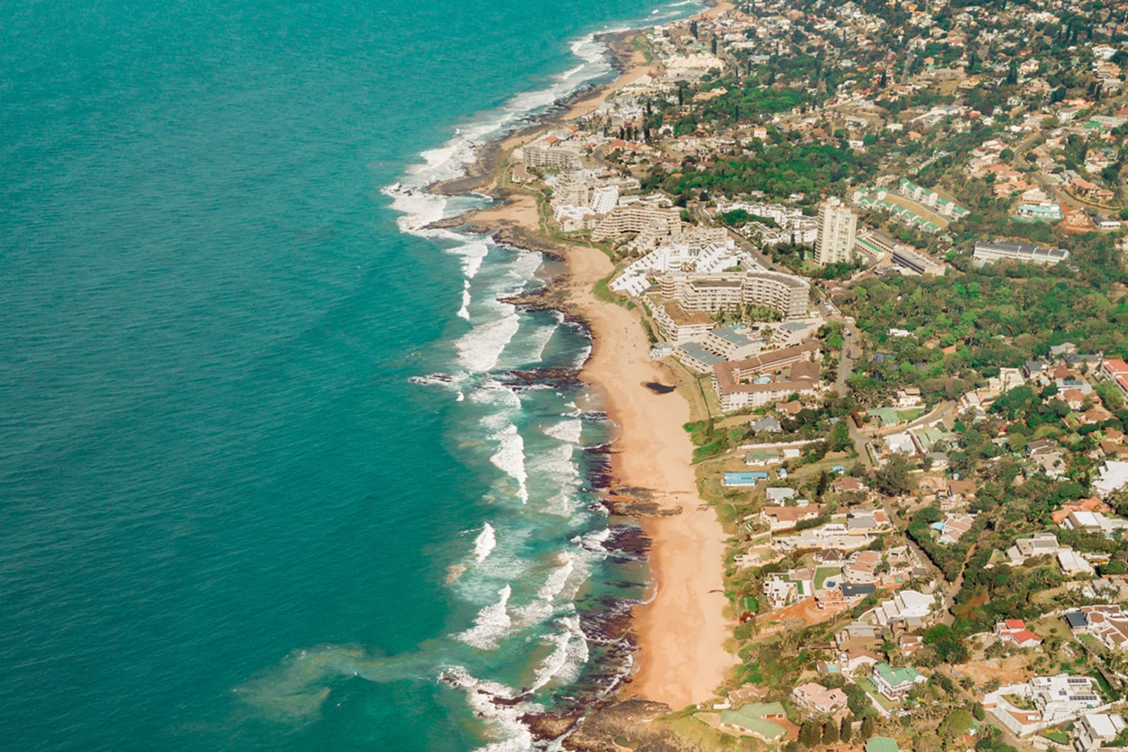
Introduction to Meridian Luxe
Welcome to Meridian Luxe
  Overview: A luxury mixed-use estate integrating residential, commercial, and lifestyle elements.
  Location: North Coast of KwaZulu-Natal, near Ballito and King Shaka International Airport.
  Vision: Redefine luxury living with eco conscious design, smart technology, and community upliftment.
  Key Features: Luxury apartments, villas, premium offices, Michelin-rated dining, wellness centers, private marina.

Slide 3

Project Vision and Objectives
Our Vision and Goals
  Vision: Become Southern Africa’s premier luxury estate, blending innovation and sustainability.
  Objectives:
    Deliver a high-value, integrated lifestyle experience for high net worth individuals and tenants.
    Achieve R4.45 billion in revenue over 10 years with a 6.5-year payback period.
    Attain Level 1 B-BBEE status with 135% procurement recognition.
    Foster community development through job creation and infrastructure support.

Slide 4
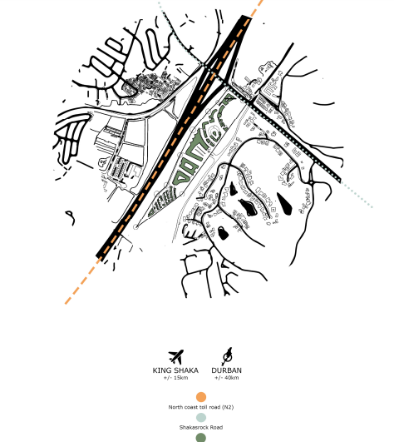
Market Opportunity
Capturing a Growing Market
  Market Context: KwaZulu-Natal’s North Coast is a hub for semigration and tourism (R10 billion economy, Source: KZN Tourism, 2024).
  Demand: Strong interest from high net worth individuals, retirees, and corporates for luxury, sustainable estates.
  Growth: Property market expected to grow at 3 to 4% annually (Source: SAPOA, 2024).
  Competitive Edge: Eco conscious design, smart technology, and proximity to N2 freeway differentiate Meridian Luxe from Zimbali, Simbithi, and Umhlanga Ridge.

Slide 5
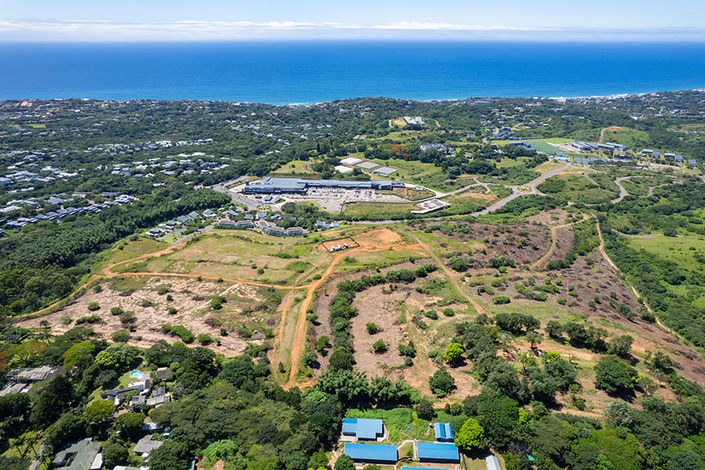
Development Overview
Meridian Luxe at a Glance
  Scope: Luxury apartments, villas, premium offices, boutique retail, wellness centers, private marina.
  Location Benefits: Adjacent to Simbithi Eco Estate, with panoramic views and N2 freeway access.
  Sustainability: Off-grid solar power system meeting most energy needs.
  Visitor Projection: Approximately 500,000 visitors annually, boosting local economy.

Slide 6
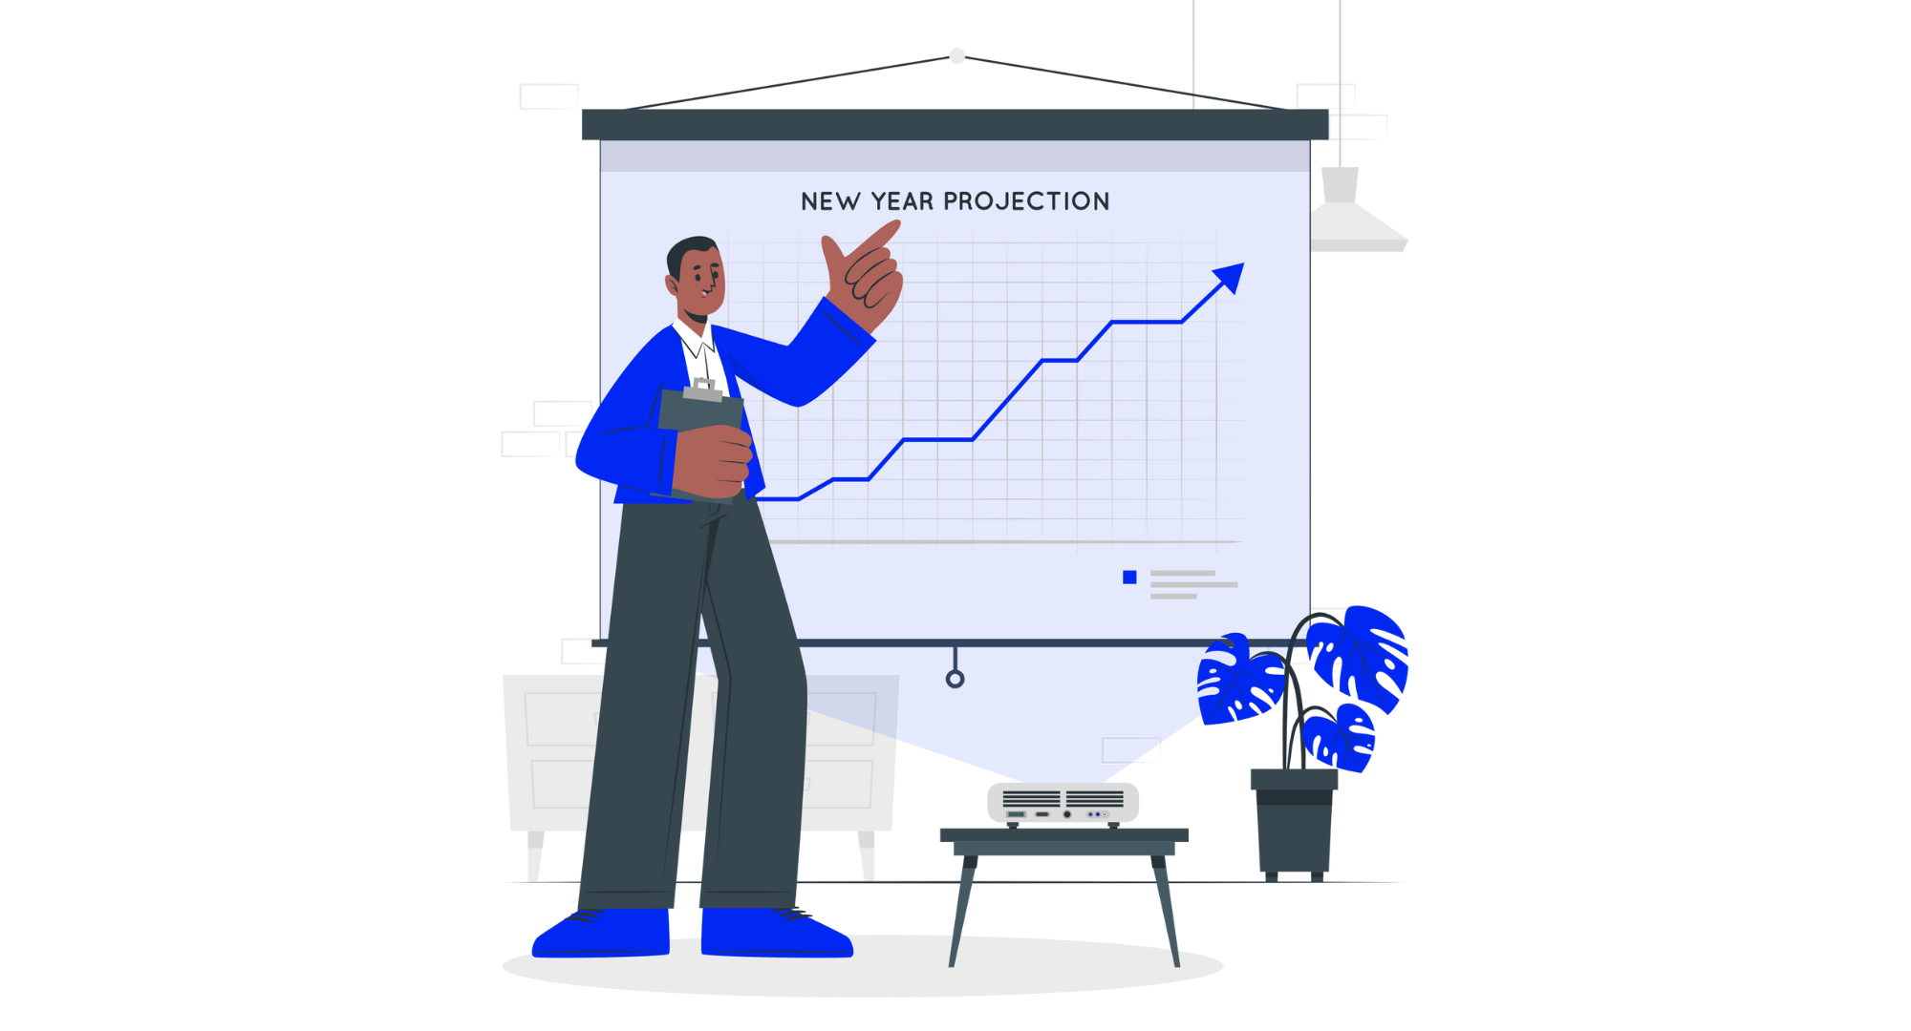
Financial Projections
Strong Financial Outlook
  Revenue: R4.45 billion over 10 years (R2.02 billion residential, R2.43 billion commercial and membership fees).
  Costs: R4.15 billion, excluding VAT (R2.5 billion land/buildings, R1 billion equipment, R500 million IT, R150 million working capital).
  Net Profit: R269 million by Year 5.
  ROI: 30.03%.
  Payback Period: 6.5 years.

Slide 7

Funding Strategy
Balanced Funding Approach
  Total Funding: R4.15 billion.
  Structure: 60% debt (R2.49 billion), 20% equity (R830 million), 20% pre-sales (R830 million, including R760 million secured).
  Grant: R50 million (pending approval) from DTIC’s Critical Infrastructure Programme for solar power system.
  Risk Mitigation: Milestone-based disbursement, diversified lending sources, fixed-cost contracts.

Slide 8
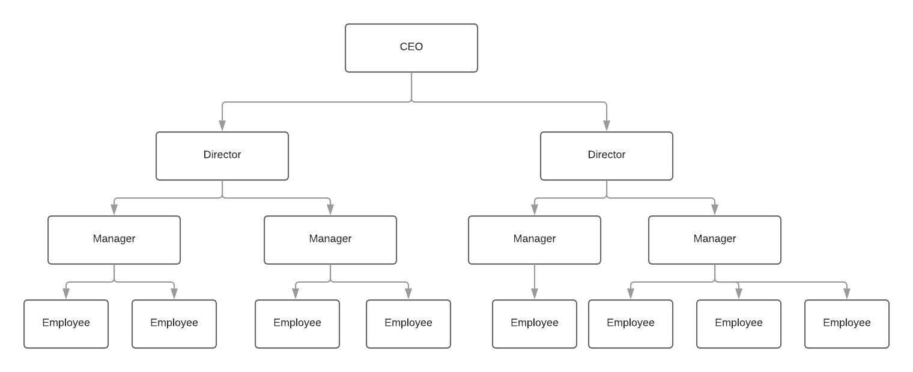
Operational Strategy
Delivering Excellence
  Staffing: 317 personnel, including 190 women, 206 youth, 292 historically disadvantaged individuals, 38 disabled.
  Technology: Smart living solutions, app-integrated concierge, automated property management.
  Phasing: Gradual rollout starting with core residential units to minimize risk.
  Management: Experienced team in property development, hospitality, and finance.

Slide 9

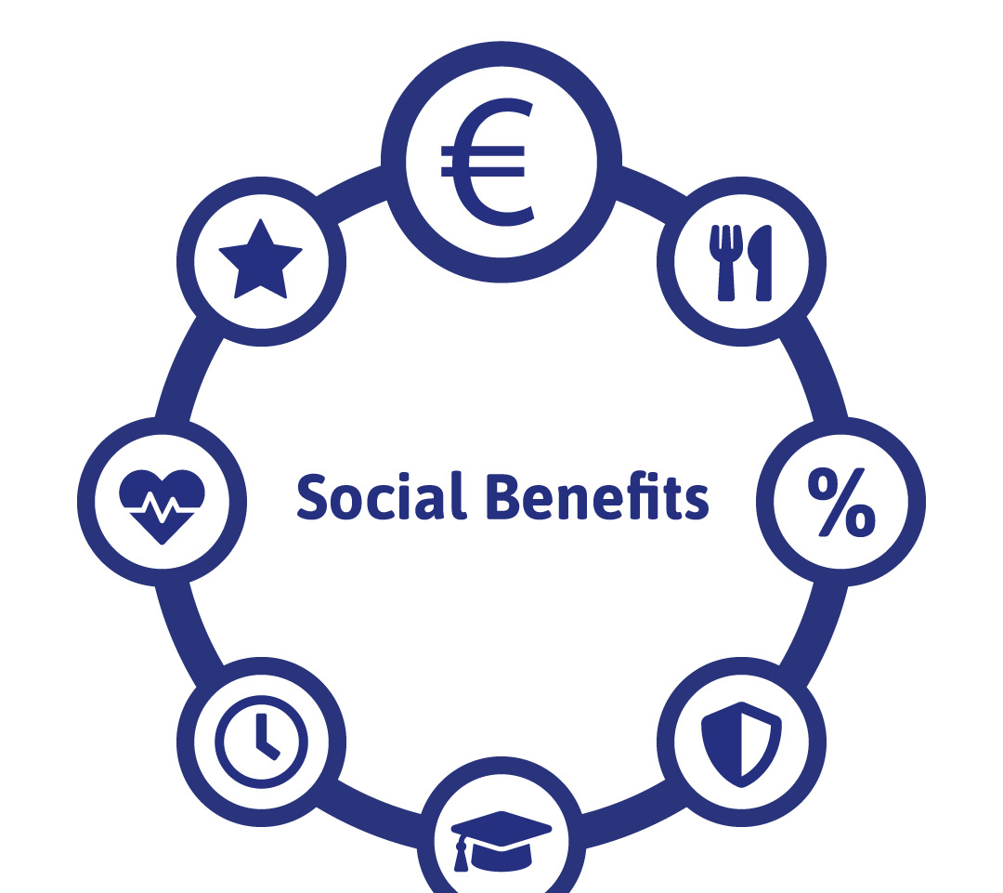


Sustainability and Community Impact
Building a Sustainable Future
  Sustainability: Off-grid solar power system, eco conscious design, potential Green Star SA certification.
  Community Impact: Job creation, skills training, infrastructure support for local communities.
  B-BBEE: Level 1 status with 135% procurement recognition, 15% black female ownership.
  Social Benefits: Enhanced local economy, inclusive workforce, community goodwill.

Slide 10

Risk Management
Mitigating Challenges
  Market Risks: Mitigated by research, anchor tenant agreements, flexible pricing.
  Financial Risks: Diversified funding, contingency funds, fixed-cost contracts.
  Operational Risks: Robust project management, reliable contractors, phased rollout.
  Regulatory Risks: Proactive engagement with authorities, legal expertise for compliance.

Slide 11

Key Recommendations
Path to Success
  Secure R4.15 billion funding, including R50 million grant.
  Launch targeted marketing to boost pre-sales and tenant acquisition.
  Prioritize sustainability with solar power and Green Star SA certification.
  Deepen community engagement through job creation and training.
  Implement phased development and rigorous risk management.
  Plan for long-term growth with scalable model.

Slide 12
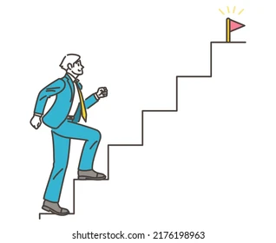
Next Steps
Moving Forward
  Finalize funding agreements by Q3 2025.
  Begin construction phase 1 by Q4 2025.
  Launch marketing campaign in Q2 2025.
  Secure anchor tenants by Q1 2026.
  Monitor market and operational KPIs continuously.
  Engage community stakeholders for ongoing support.

Slide 13

Conclusion
Meridian Luxe: A Vision Realized
  Summary: Meridian Luxe is a transformative luxury mixed-use development on KwaZulu-Natal’s North Coast, poised to redefine living standards with its eco conscious design, smart technology, and integrated lifestyle offerings. With projected revenue of R4.45 billion over 10 years, a robust funding plan of R4.15 billion, and a net profit of R269 million by Year 5, the project offers a compelling investment opportunity with a 6.5-year payback period and 30.03% ROI.
  Key Strengths: Strategic location near Ballito, sustainable infrastructure like an off-grid solar power system, and a commitment to community upliftment through Level 1 B-BBEE status and local job creation.
  Call to Action: Join Success 101 Developments in shaping the future of luxury living, delivering value to investors, residents, and the KwaZulu-Natal community.
  Thank You: We appreciate your time and consideration. Together, we can build a legacy of innovation, sustainability, and prosperity.
  Contact: For further details, reach out at francois@mintfresh101.co.za or +27 79 790 2327.

Slide 14

THANK YOU

